Slide 2
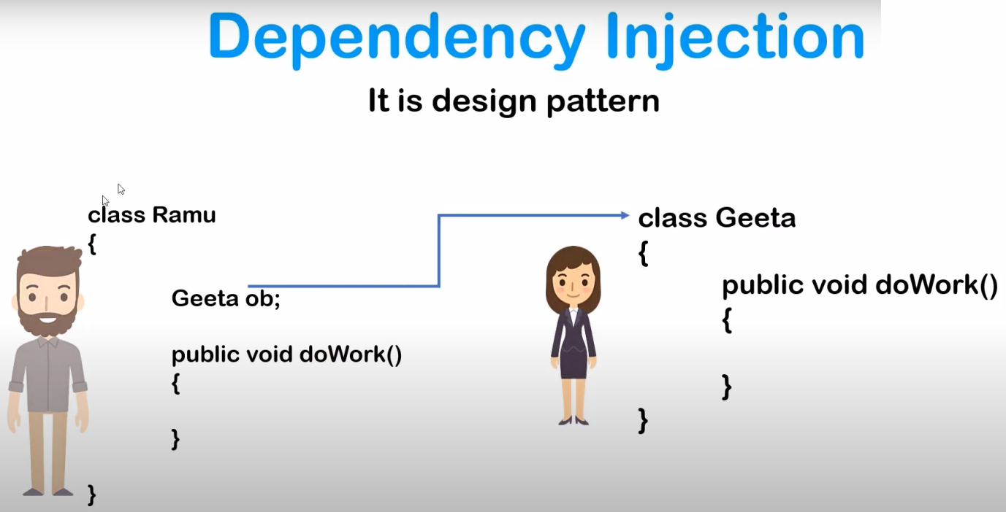

Slide 3
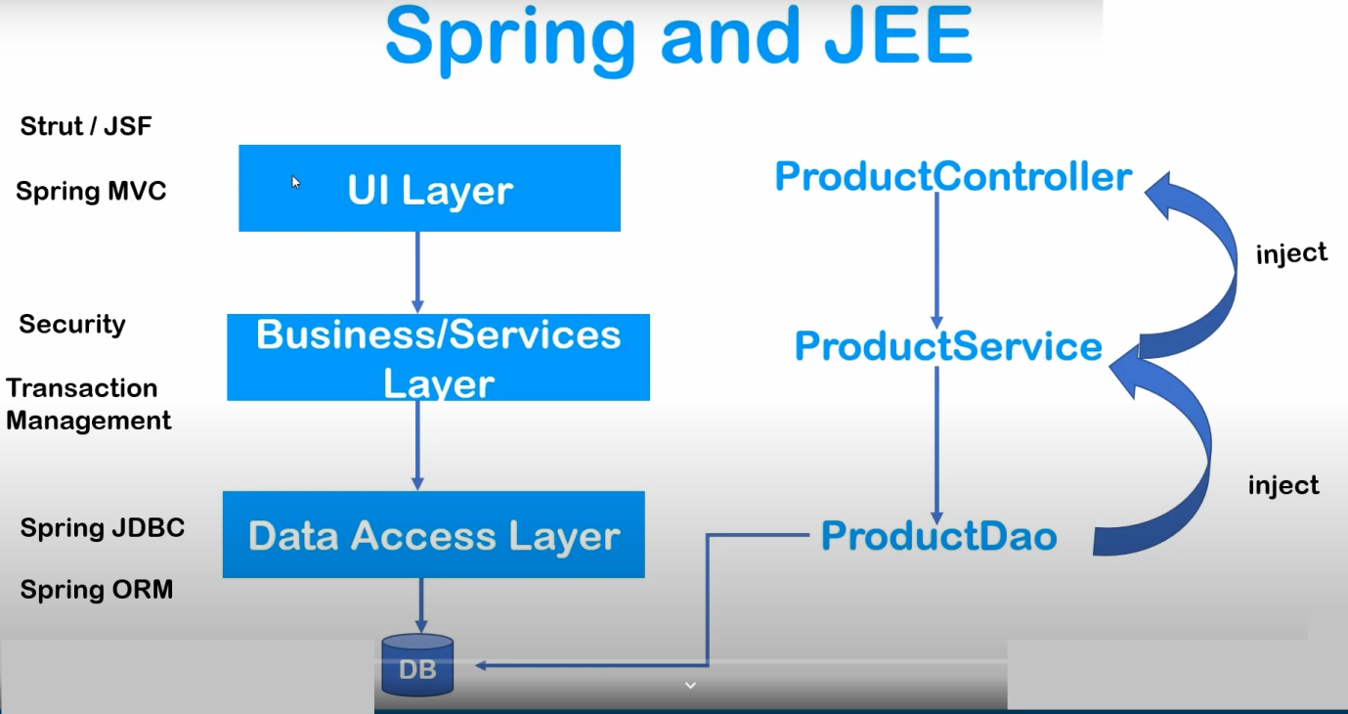

Slide 4
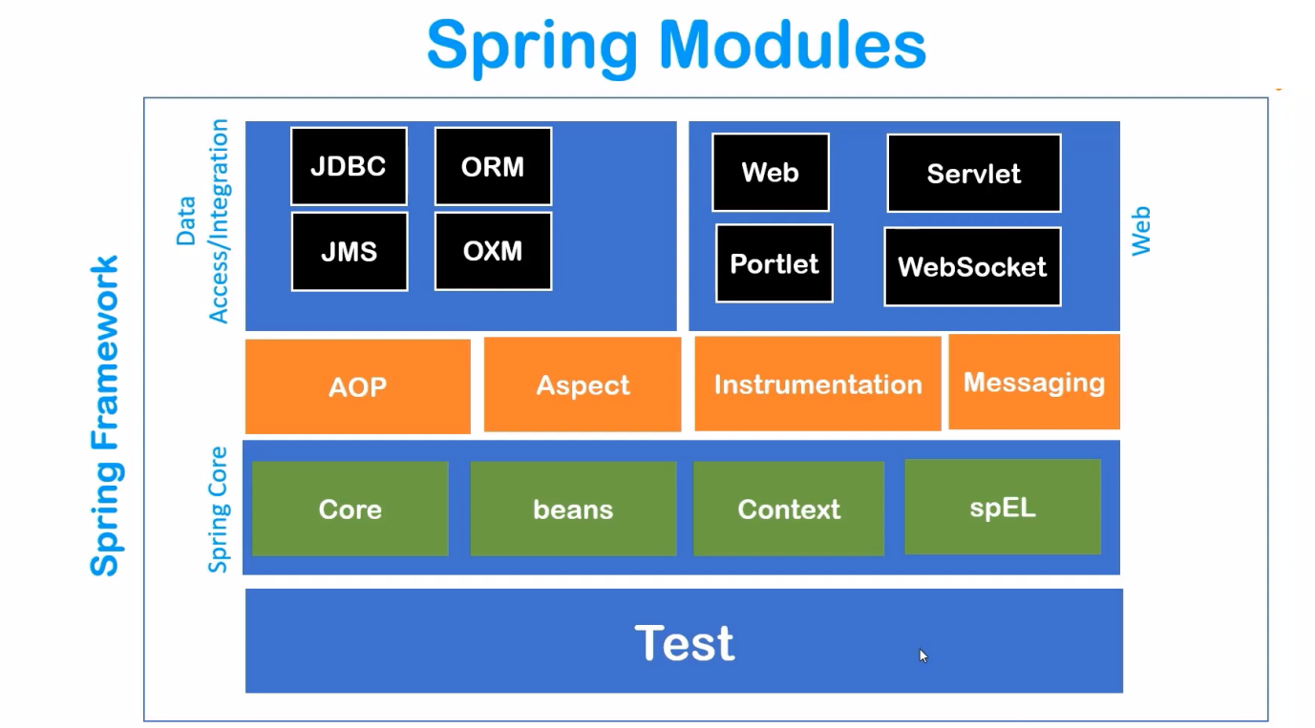

Slide 5
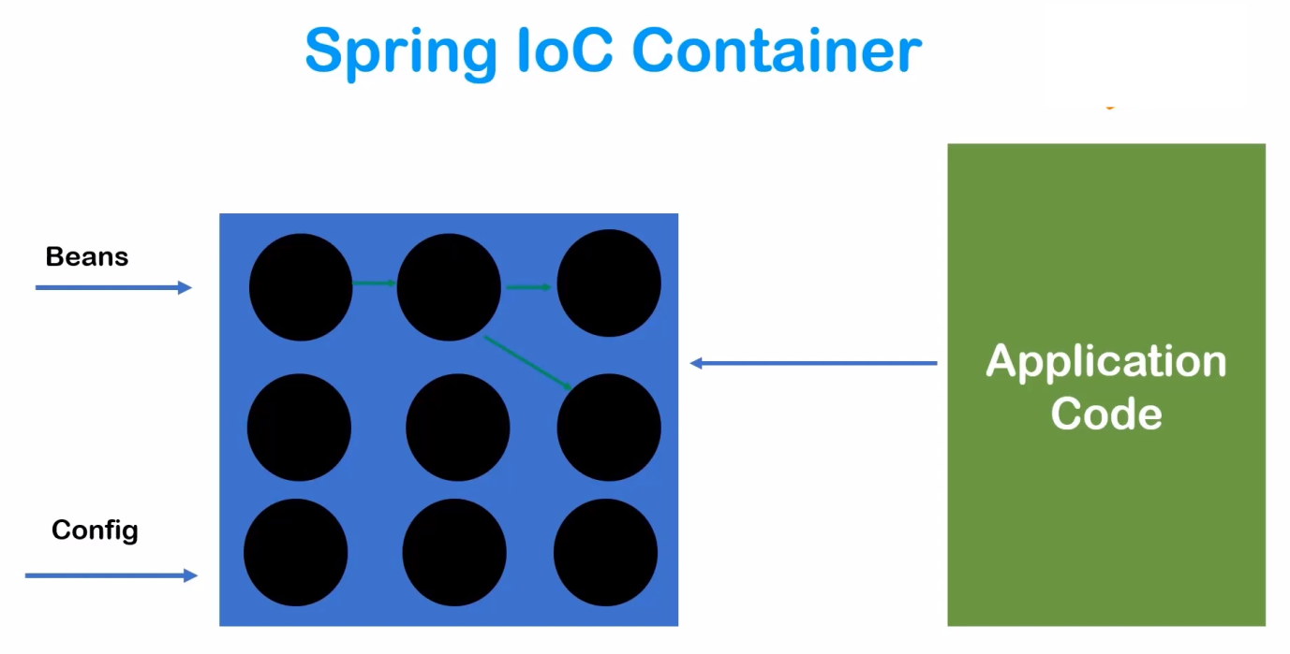

Slide 6
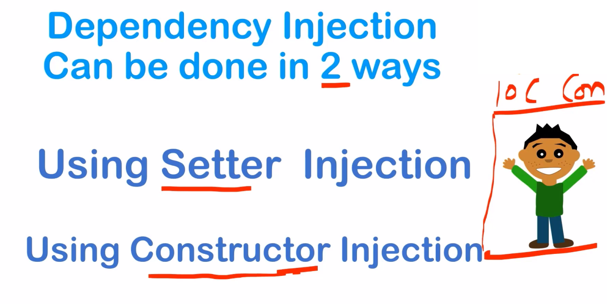

Slide 7
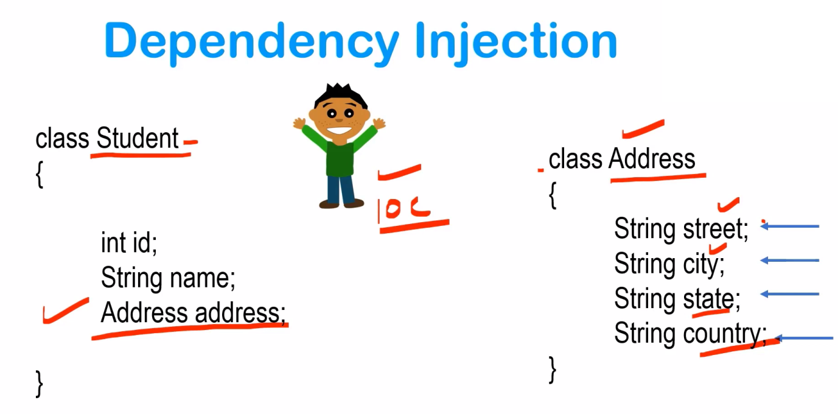

Slide 8
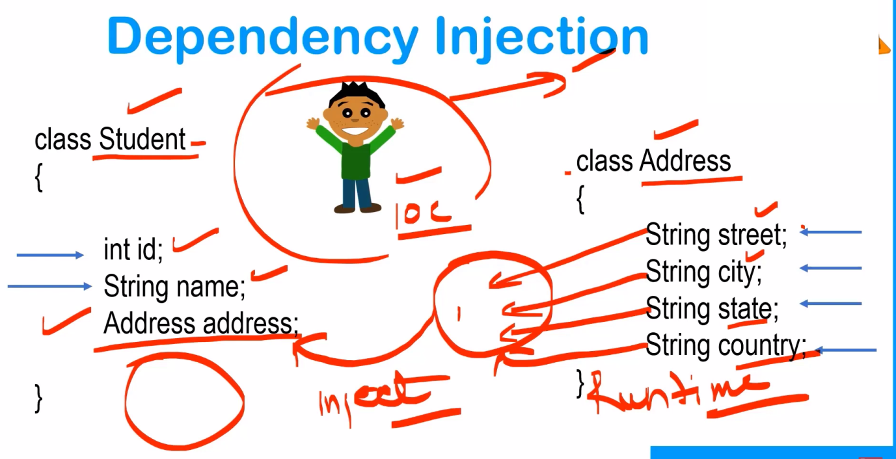

Slide 9
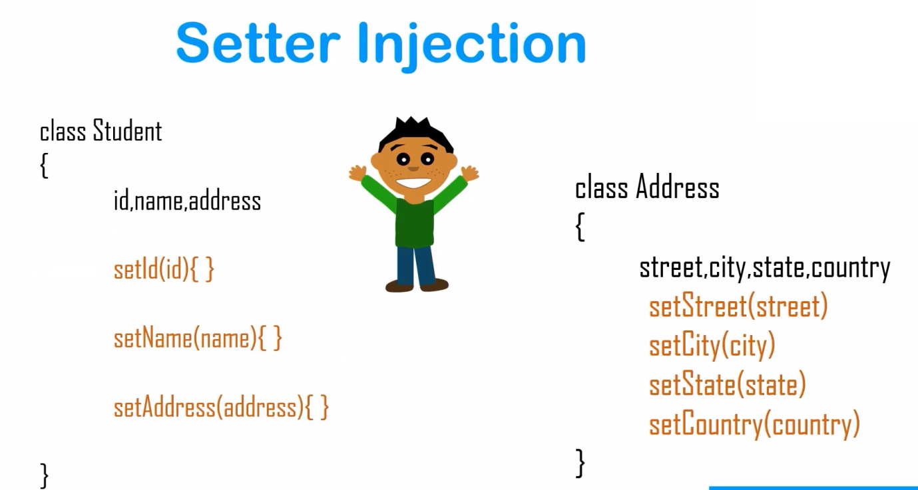

Slide 10
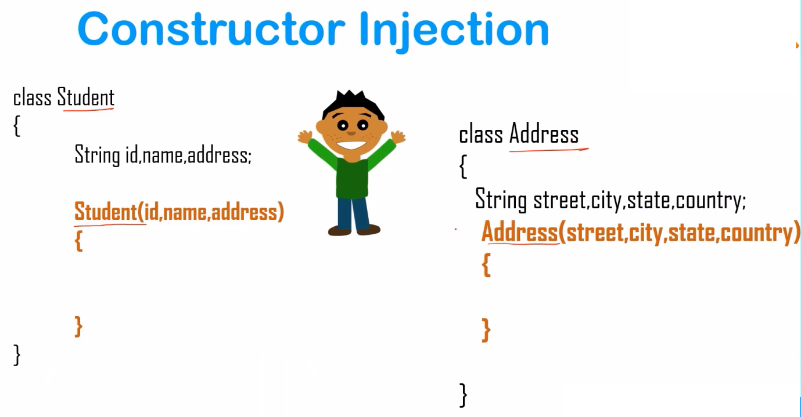

Slide 11
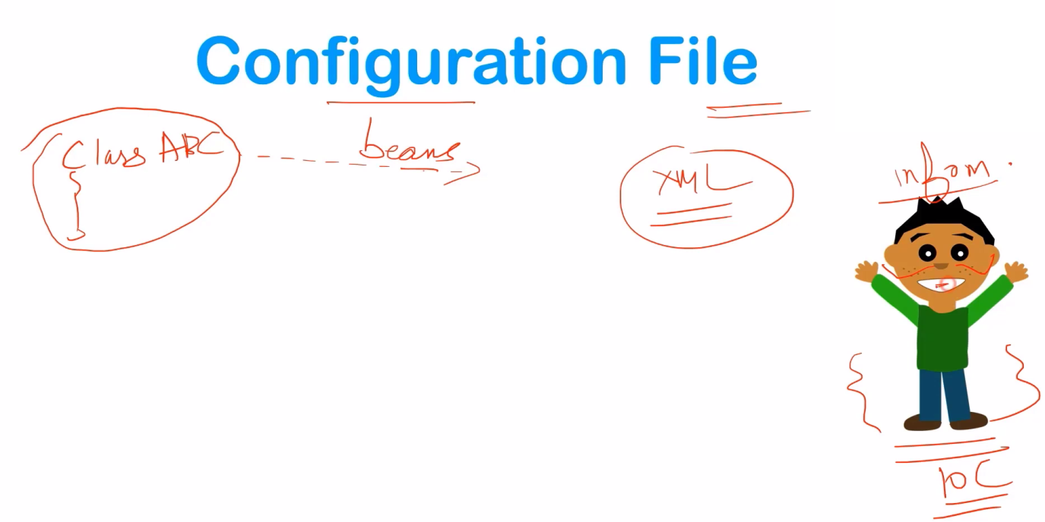
1. XML Based Configuration
2. Annotation Based Configuration
3. Java Based Configuration

Slide 12
<?xml version = "1.0" encoding = "UTF-8"?> <beans xmlns = "http://www.springframework.org/schema/beans" xmlns:xsi = "http://www.w3.org/2001/XMLSchema-instance" xsi:schemaLocation = "http://www.springframework.org/schema/beans http://www.springframework.org/schema/beans/spring-beans-3.0.xsd">
<!-- A simple bean definition --> <bean id = "..." class = "...">
<!-- collaborators and configuration for this bean go here --> </bean>
<!-- A bean definition with lazy init set on -->
<bean id = "..." class = "..." lazy-init = "true"> <!-- collaborators and configuration for this bean go here --> </bean>
<!-- A bean definition with initialization method -->
<bean id = "..." class = "..." init-method = "...">
<!-- collaborators and configuration for this bean go here -->
</bean>
<!-- A bean definition with destruction method -->
<bean id = "..." class = "..." destroy-method = "...">
<!-- collaborators and configuration for this bean go here --> </bean>
<!-- more bean definitions go here --> </beans>

Slide 13
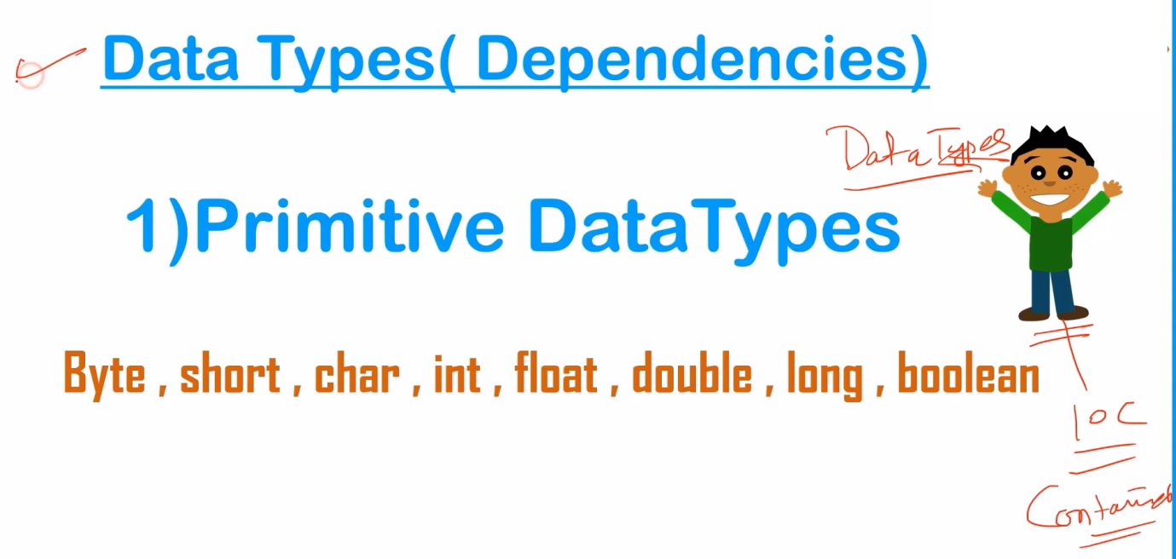

Slide 14


Slide 15
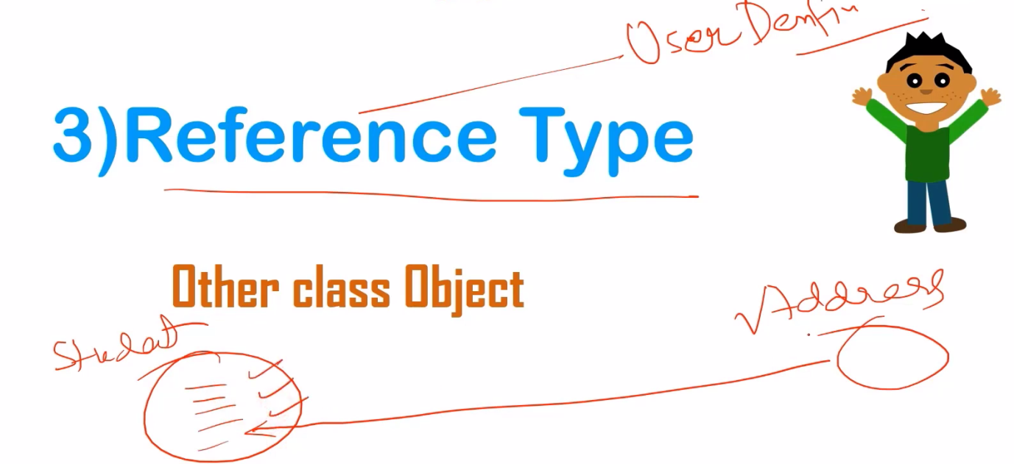

Slide 16
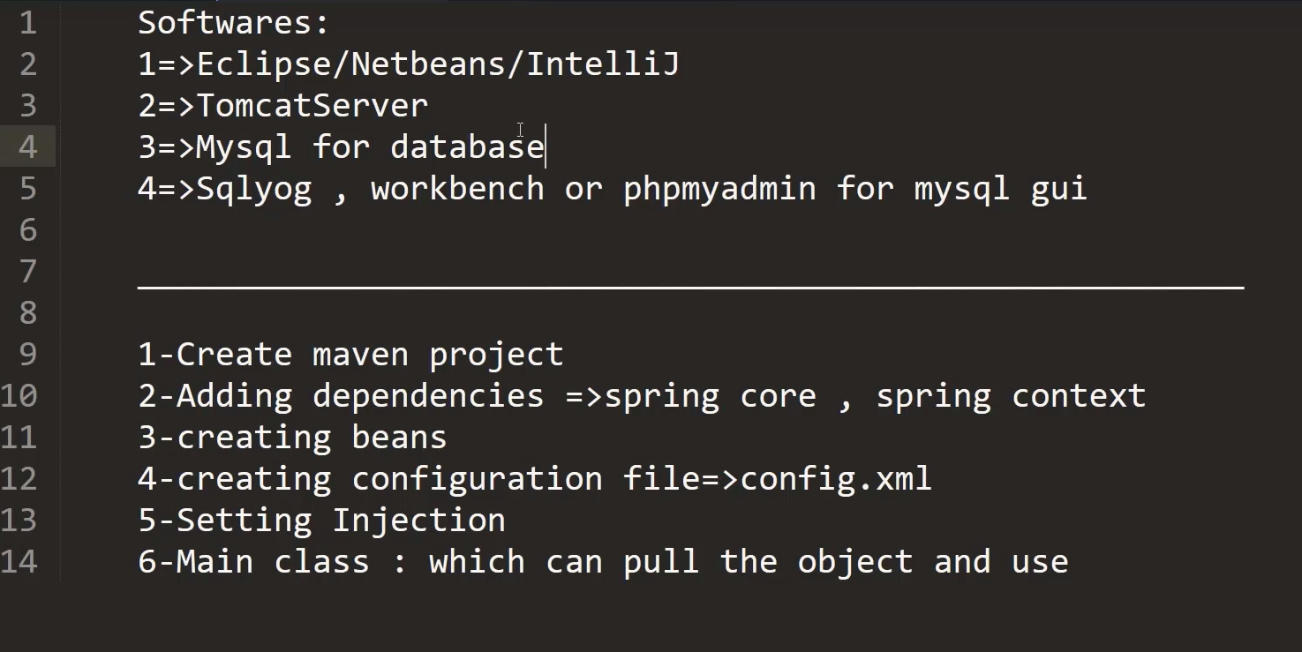

Slide 17
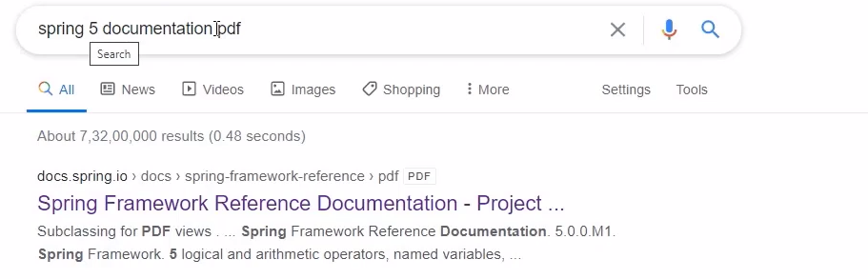

Slide 18
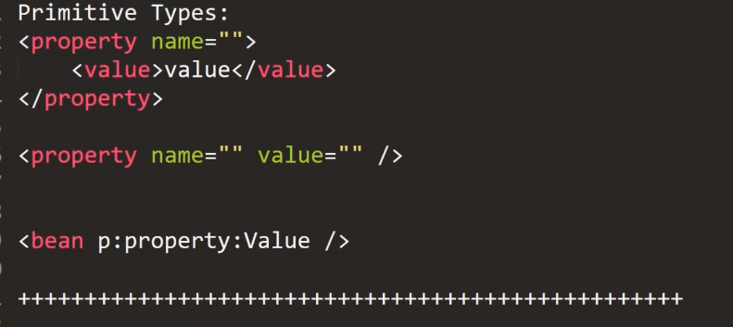

Slide 19
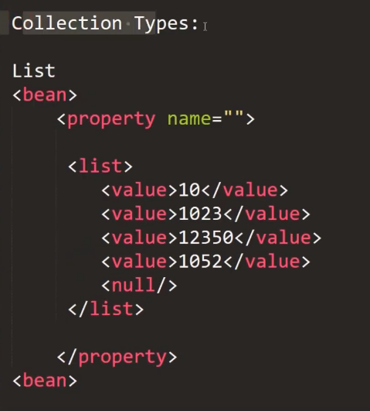

Slide 20
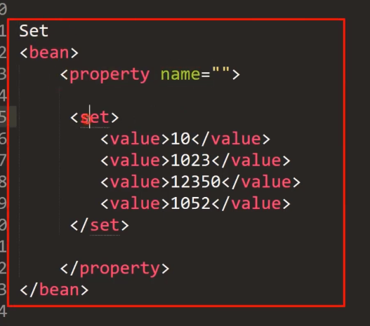

Slide 21
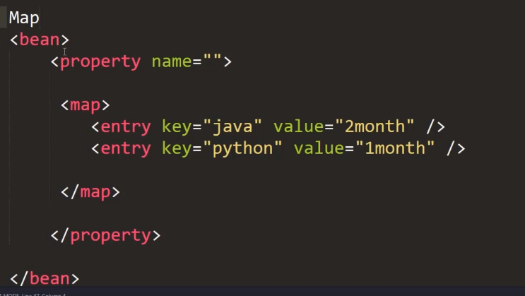

Slide 22
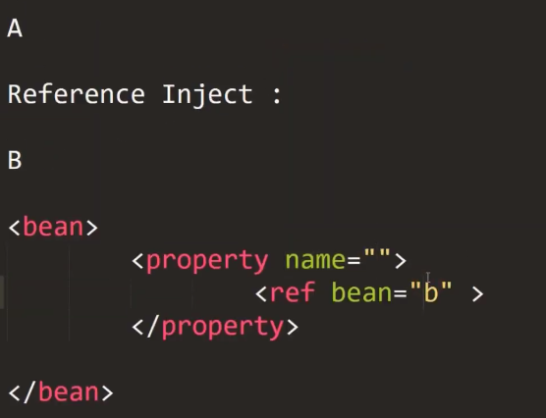
Reference Type

Slide 23
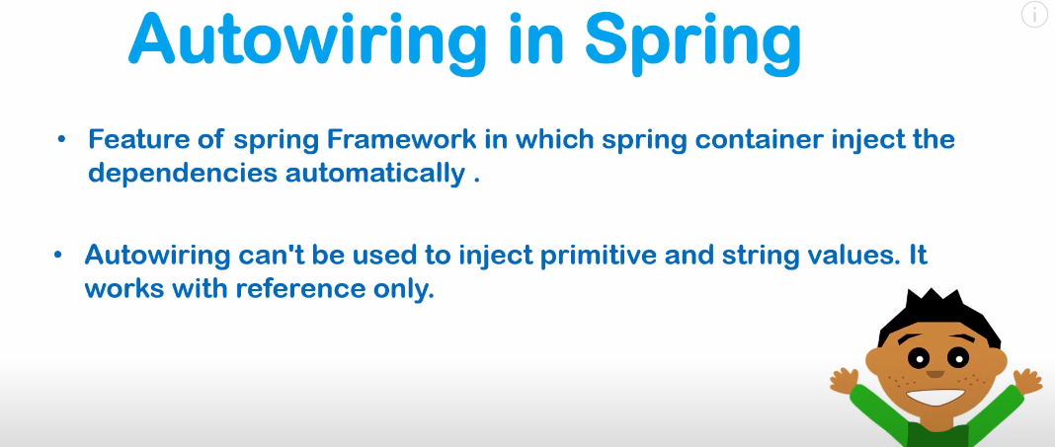

Slide 24
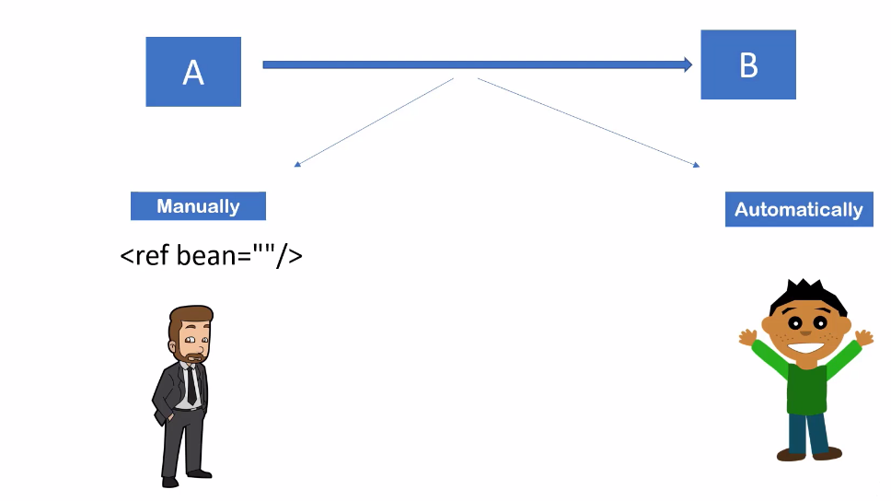

Slide 25
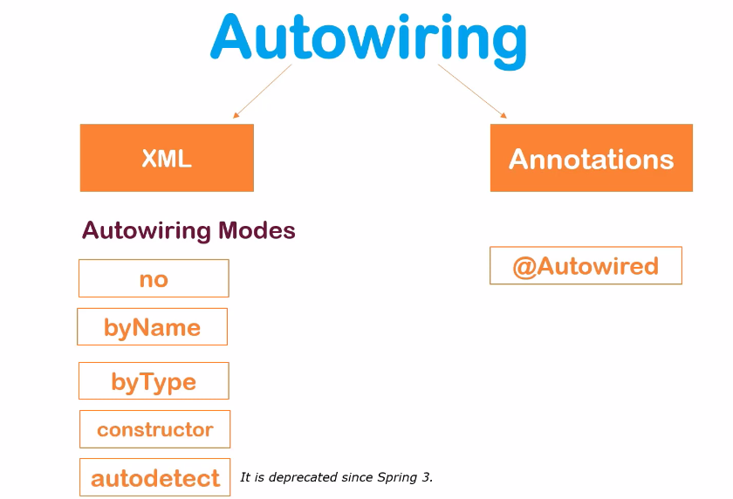

Slide 26
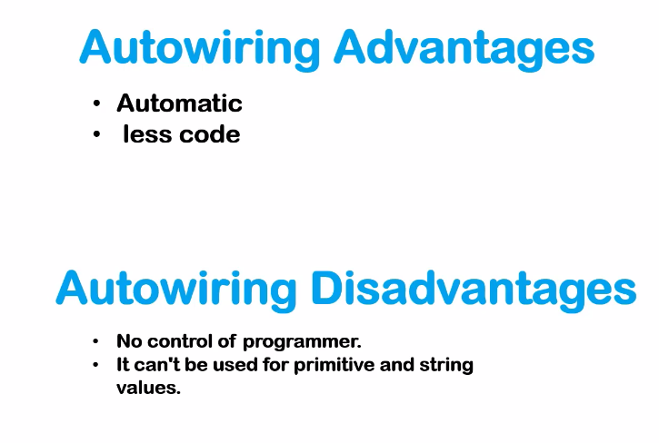

Slide 27
Autowiring modes:
no:
Default, no auto wiring, set it manually via “ref” attribute as we have done in dependency injection via settor method post.
byName:
Autowiring by property name. Spring container looks at the properties of the beans on which autowire attribute is set to byName in the XML configuration file and it tries to match it with name of bean in xml configuration file.
byType:
Autowiring by property datatype. Spring container looks at the properties of the beans on which autowire attribute is set to byType in the XML configuration file.
It then tries to match and wire a property if its type matches with exactly one of the beans name in configuration file. If more than one such beans exists, a fatal exception is thrown.
contructor:
byType mode in constructor argument.

Slide 28
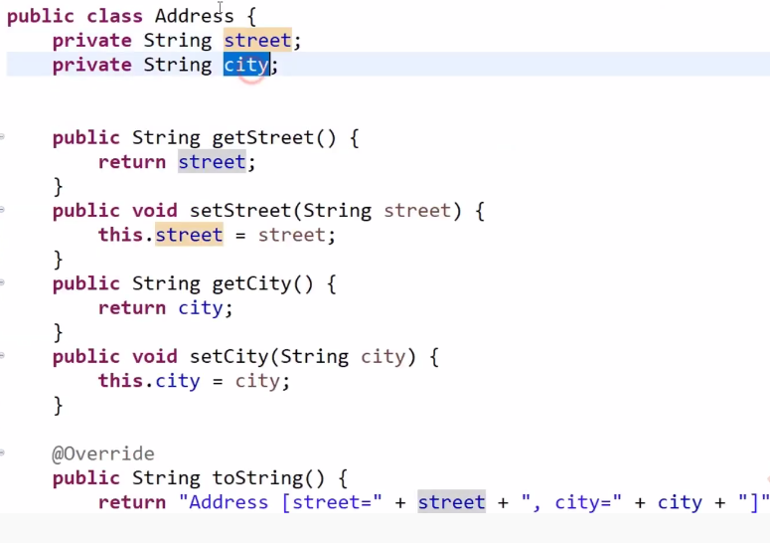

Slide 29
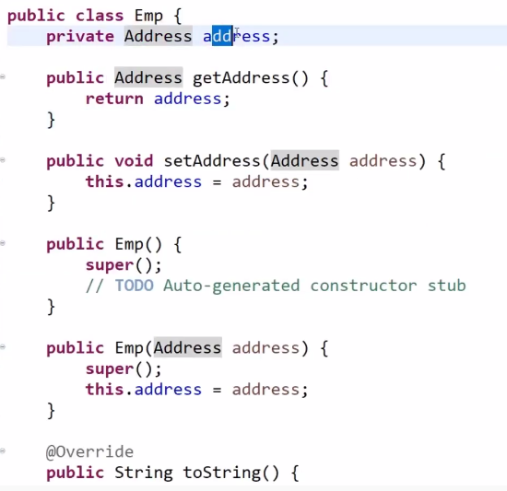

Slide 30
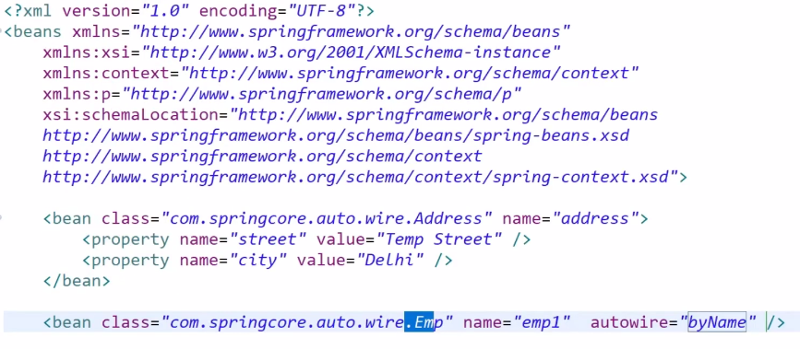

Slide 31
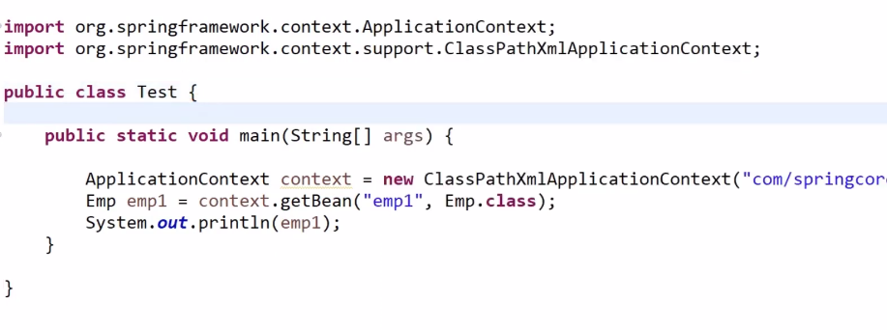

Slide 32
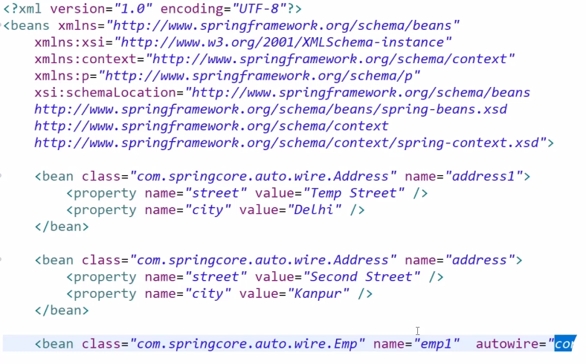

Slide 33
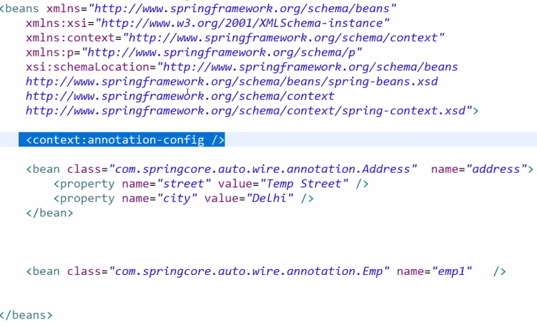

Slide 34
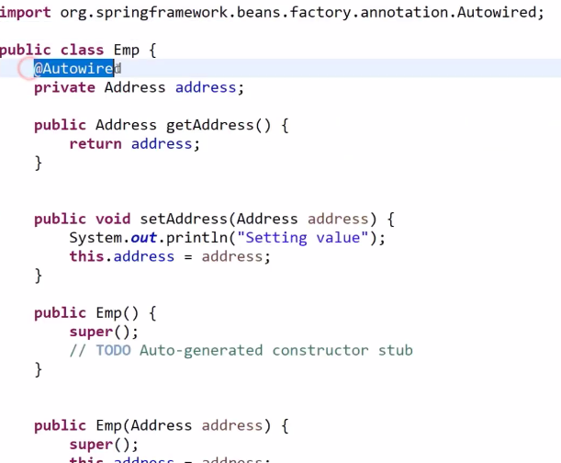

Slide 35
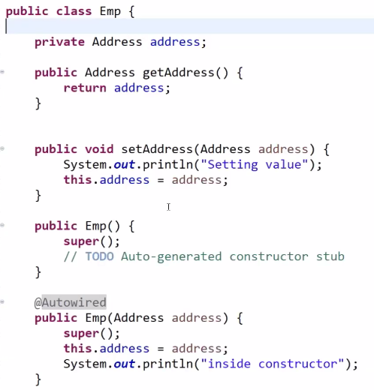

Slide 36
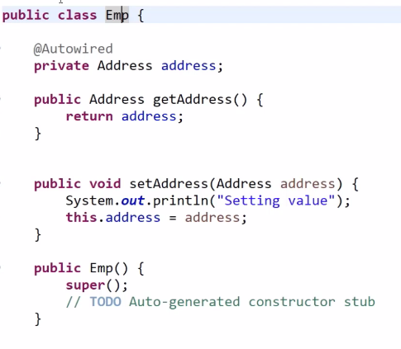

Slide 37
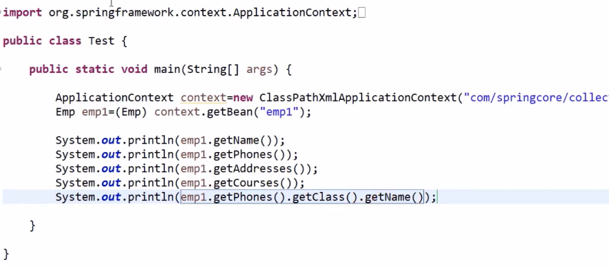

Slide 38
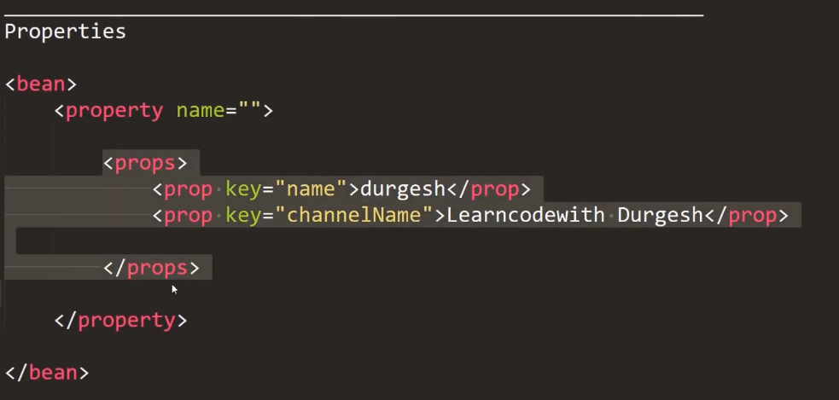

Slide 39
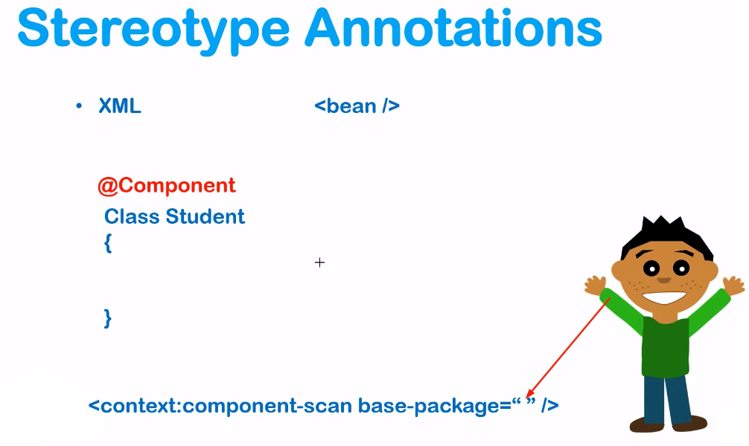

Slide 40
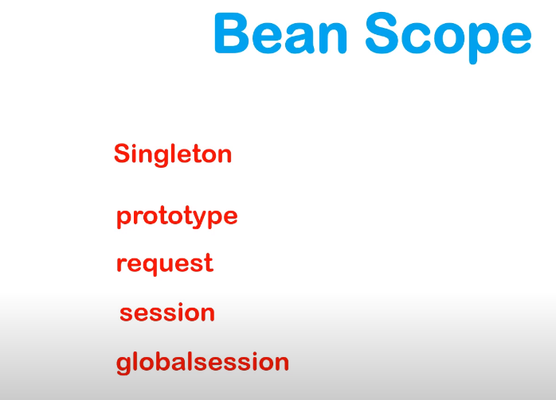

Slide 41
The objects that form the backbone of your application and that are managed by the Spring IoC container are called beans.
A bean is an object that is instantiated, assembled, and otherwise managed by a Spring IoC container. These beans are created with the configuration metadata that you supply to the container.
For example, in the form of XML <bean/> definitions

Slide 42
In Spring, bean scope is used to decide which type of bean instance should be return from Spring container back to the caller.
There are 5 types of bean scopes supported in spring
singleton – Scopes a single bean definition to a single object instance per Spring IoC container.
prototype – Return a new bean instance each time when requested
request – Return a single bean instance per HTTP request.
session – Return a single bean instance per HTTP session.
globalSession – Return a single bean instance per global HTTP session.

Slide 43
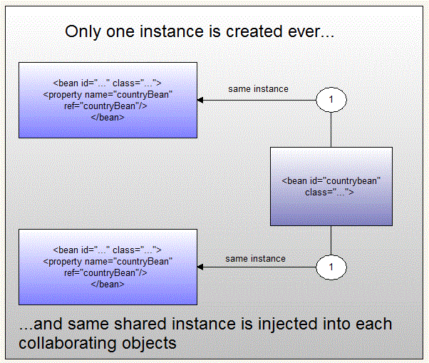
Singleton bean scope

Slide 44
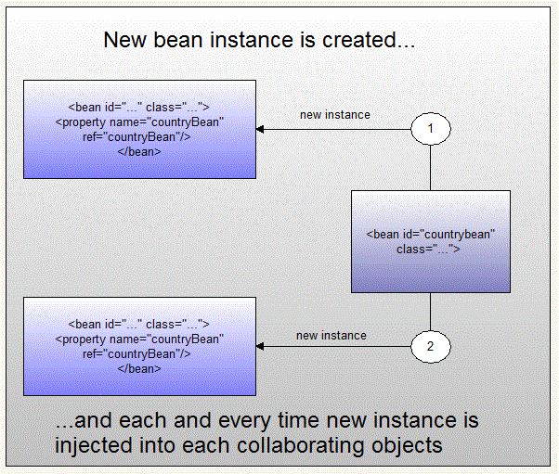
Prototype bean scope

